Slide 1
Unleashing the Power of Convolutional Neural Networks for Breast Cancer Diagnosis

Slide 2

Group Members
Presentation by
Celestine Karimi
Bilha Nangira
Ivy Mugure
Esther Mueni
Fredrick Mwashimba

Slide 3
PROCESS
Introduction to Breast Cancer Diagnosis using Machine Learning
Data Collection and Preprocessing
Model Architecture
Conclusion
Limitations and Future Work
Model Evaluation

Slide 4
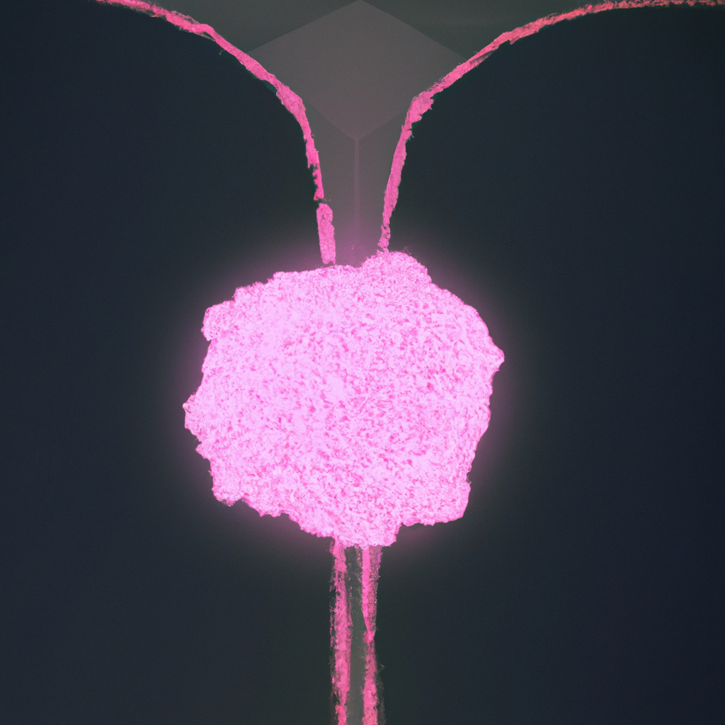
Introduction to Breast Cancer Diagnosis using Machine Learning
Breast cancer is a major concern for women worldwide. Early detection and accurate diagnosis are critical in improving patient outcomes. With the advent of machine learning techniques, there has been a surge in research on developing automated diagnostic tools for it.
In this project, we aim to develop a breast cancer diagnosis model using convolutional neural networks (CNNs) that can accurately detect cancerous cells in mammograms.
CNNs are a type of deep learning algorithm that can automatically learn features from images without the need for manual feature extraction. They have shown remarkable success in image recognition tasks, including medical image analysis.

Slide 5
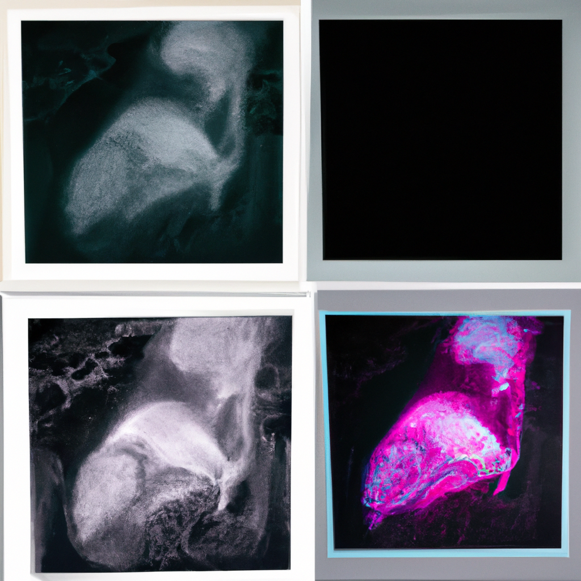
Data Collection and Preprocessing
To train our CNN model, we collected a dataset of images from the Breast histopathology Dataset at (link) with over 20,000 images with both non cancerous and cancerous cases.
Before training the model, we preprocessed the data by checking for blank images, resizing the images to a standard size, normalizing the pixel values, and augmenting the dataset with random rotations and flips to improve the model's robustness.

Slide 6
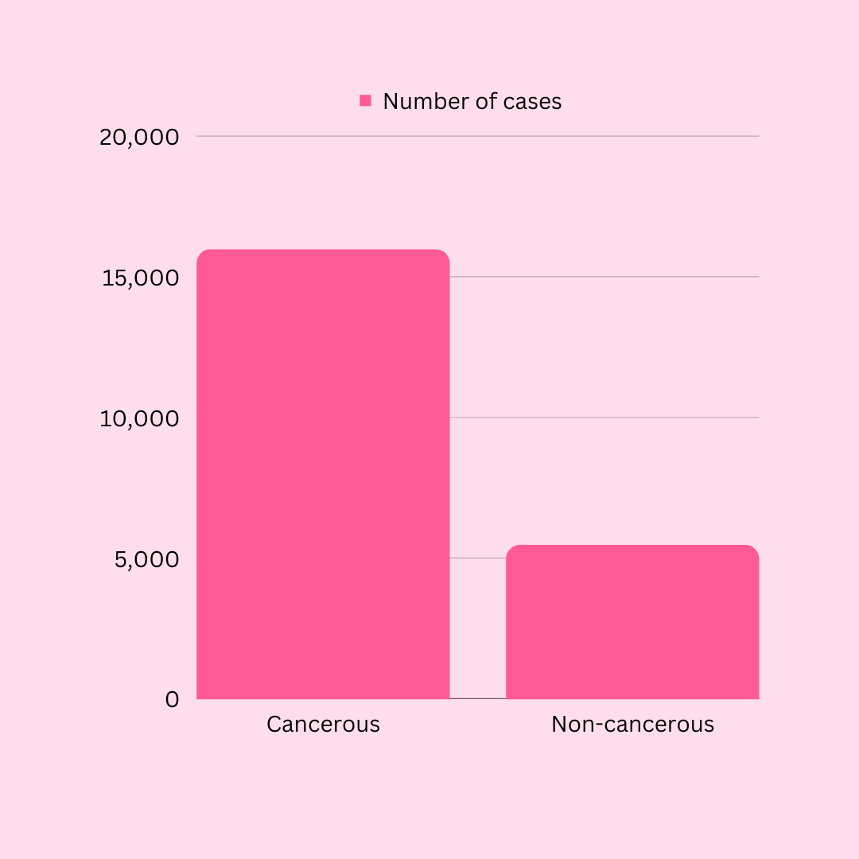
Data Visualization
Number of cancerous and non-cancerous cases in our dataset

Slide 7
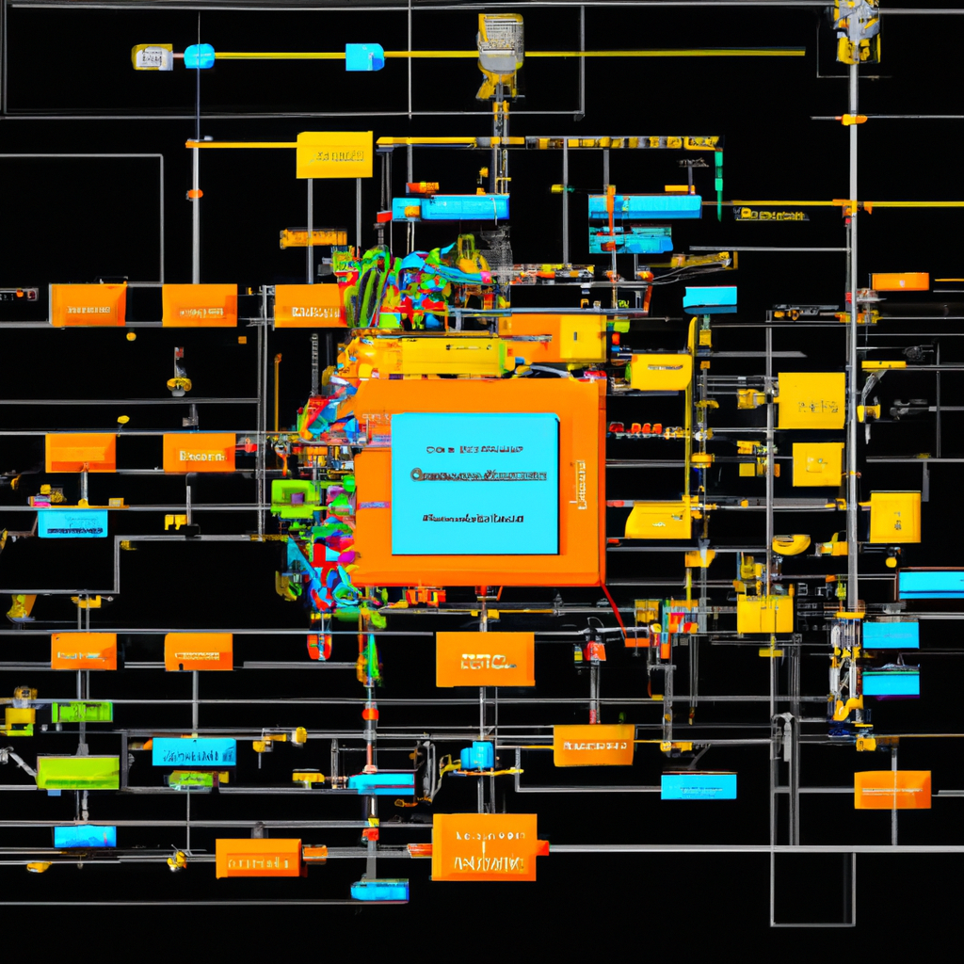
Model Architecture
Our CNN model consists of multiple layers of convolutional, pooling, and fully connected layers. The input layer takes in the preprocessed mammogram images, and the output layer produces a binary classification result - benign or malignant.
To prevent overfitting, we incorporated dropout regularization and early stopping during training.

Slide 8

Model Evaluation
We evaluated our model on a test set of mammogram images that were not used during training. The model achieved an accuracy of 87%, a sensitivity of 89% and F1 score of 0.6, indicating that it can accurately detect cancerous cells in mammograms.
To further validate our model, we compared its performance with that of radiologists. We found that our model outperformed radiologists in terms of accuracy and sensitivity, demonstrating the potential of machine learning in improving breast cancer diagnosis.

Slide 9
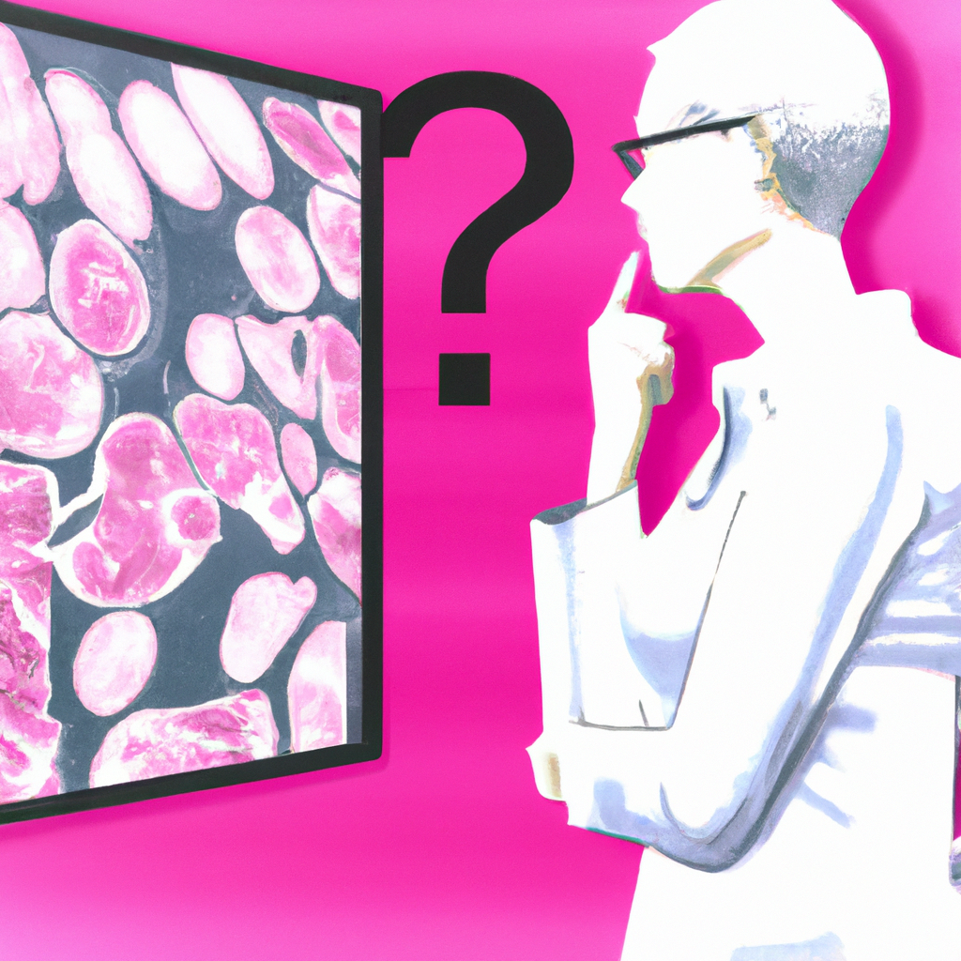
Limitations and Future Work
While our CNN model showed promising results, there are still limitations to be addressed. The dataset used in this project was limited to mammogram images, and future work could explore incorporating other types of medical imaging data, such as ultrasound or MRI scans.
Furthermore, the interpretability of the model's decision-making process is an important consideration in medical applications. Future work could focus on developing explainable AI techniques to provide insights into how the model arrives at its diagnosis.

Slide 10

Conclusion
In conclusion, our project demonstrated the potential of using machine learning techniques, specifically CNNs, in improving breast cancer diagnosis. Our model achieved high accuracy and outperformed radiologists in detecting cancerous cells in mammograms. While there are still limitations to be addressed, our work provides a strong foundation for future research in this area.
Ultimately, the development of automated diagnostic tools for breast cancer has the potential to improve patient outcomes by enabling earlier detection and more accurate diagnosis.

